Slide 1
Session 5 Budget and Budget Justification
FISH 521

Slide 2
General comments on work plan
Use sample sizes
If possible, explain that you have sufficient power
Use consistent tense
Future tense for things that will be done
Past tense for stuff that has been done
End with interpretation, expected results, significance or something similar
Not too much though
Don’t go back into rationale
Graphs and tables are useful and break up the text
Timeline should have a legend / caption
Try to be as specific as possible
But avoid unnecessary details

Slide 3
Flow of a typical proposal
Scientific Idea
Goals of funding body (?)
Conceptual
Framework
Proposal Format
Administrative
tasks (?)
Proposal preparation
Deadlines
Budget
Information needed?
Sampling & Research Permits
Award timeline
University Approvals
Submission Process

Slide 4
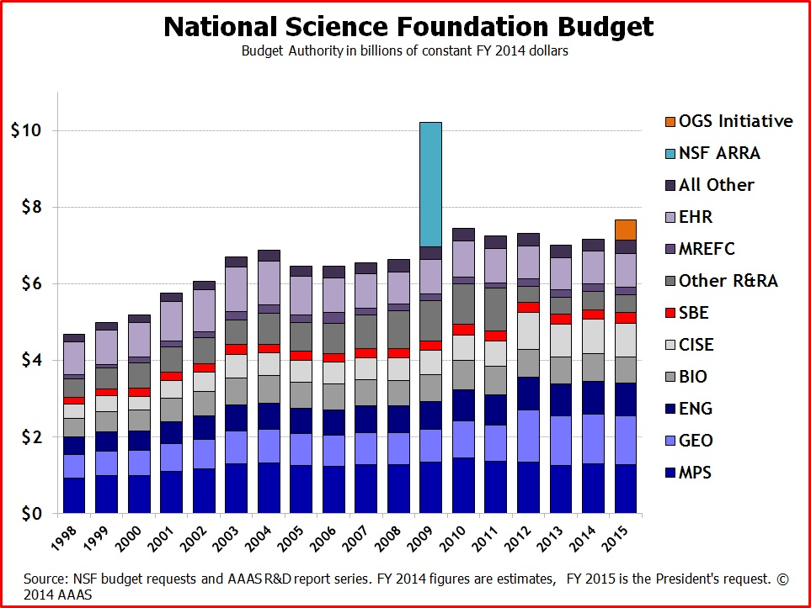
The National Science Foundation
Mission
To promote progress in basic science
Goals: discovery, learning, research, infrastructure and stewardship
Budget
$ ~ 7 billion
Fund 10,000 new awards per year
Average duration 3 years
Usually research proposals, but also equipment, fellowships etc.

Slide 5
NSF structure
National Science Board
Director
Office of the Director
Office of the
Inspector General
Office of
Polar Programs
Office of
International Science
Directorate for
Biological Sciences
Directorate for
Geosciences
Division of
Environmental Biology
Division of Ocean Sciences
Other Divisions
Other Divisions
Other Directorates
Other Offices
Different priorities and deadlines
Talk to program officers
Possibly several programs

Slide 6
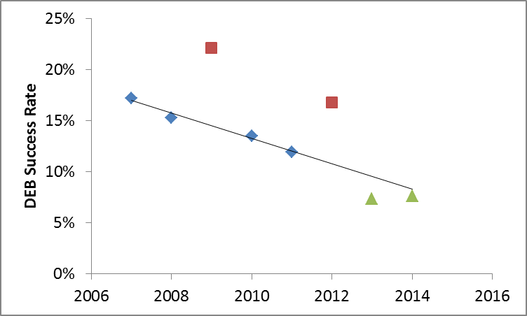
Success Rate
Differs between funding bodies and divisions
Fairly low for NSF
Especially BIO
BIO now with preproposal stage
Only one round per year
January preproposala
July: full proposals
Others too (e.g. Sea Grant)
Few people get grants the first time
2.2 submissions before award
Revise and resubmit
Data available from FastLane
Call for
Preproposals
Preproposal
Panel Review
Decline
Invite
Full Proposal

Slide 7
Budget
Nitty-critty bean counting, but important
Contract
Too expensive
You won’t get the award
Too cheap
You won’t get the award
If you get the award, you won’t have sufficient money to do the proposed work
Legalities
UW is legally responsible
PI can be held accountable

Slide 8
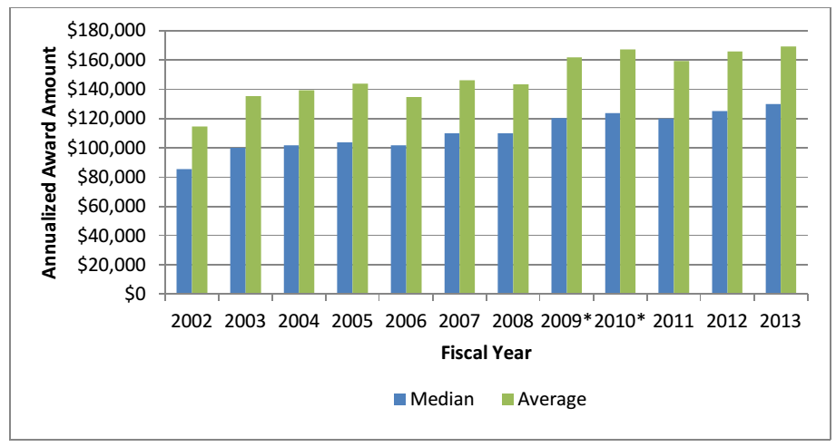

Slide 9
Office of Sponsored Research
RFP
PI prepares
proposal
Check proposal
Budget errors
Indirect costs
Cost sharing
Legal issues
Jurisdiction
Intellectual property right
Permits
IACUC
Human subjects
Need time
10 days
Draft of proposal
budget
Proposal
Preparation
eGC1
Proposal
Revision
Dept. Review
Jessica
Ok?
Chair, Dean
OSP
Ok?
Submission

Slide 10
Direct and indirect costs
Direct costs
Directly incurred by the project
E.g. your salary, equipment, supplies
Indirect costs
Costs incurred for maintenance
administrative and clerical salaries, office supplies, toner cartridges, telephone charges, cellular phones, pagers, and related service charges, routine copying charges, memberships, journal subscriptions
These costs can usually not be included as direct costs
Some exceptions: NSF allows administrative salaries if needed
Basis for calculating indirect costs
MTDC – modified total direct costs
Excludes equipment and tuition
Rate
On campus: 56%
Off campus: 26%

Slide 11
Cost Sharing
Many federal sponsors
Not NSF
State shares cost
Non-federal funds
State collaborators
University
Falls under previous rules
E.g. Salary: faculty time (+ benefits + indirect)
Have to work on project
Still time available
Current and pending support
UW discourages committing cost sharing if not required
Paperwork – has to be documented
Legal requirements
Limits flexibility
List in budget and budget justification
Does TA count?

Slide 12
Budget Categories
Salaries
Calculate accurately
Increase by 4% each year
Fringe Benefits
Employer benefits contributions
Different rates
Equipment
> $ 2,000
Supplies
Travel
National vs international
May need US carrier
Contractual Services
Bench fees, camp fees
subcontracts
Other
Graduate tuition
Annual increase
Publication costs
Budget Template
NSF on webpage – don’t use
Budget template
Rates are wrong
SAFS Budget site
Link on website
Need to be allocated accurately
Later change may require sponsor’s permission
Costs need to be distributed fairly among projects
E.g. labs, field camps, etc
Cost centers

Slide 13
Financial compliance
Use the money for what you said you would use it for
Salary
Only work actually carried out
Based on percentage time spent on work
Pay salary based on effort, not on funding
Equipment and Supplies
Direct benefit to project
Proportional allocation
Major changes (>20%)
Need approval by sponsor
If audit
Expenses can be disallowed
Funds have to be repaid to the sponsor

Slide 14
Budget Justification
Effort
Who, salary level, % FTE, duration
Include undergraduate hourly
Equipment
Why needed?
Supplies
Brief
Travel
Describe why, where and who
Subcontracts
Benefit to project
Not more than 3 pages
1 is usually enough
See example proposals on catalyst

Slide 15
Panel Exercise
Work Plan
Discuss
Discuss link to objectives
Budget
Discuss in connection to work plan
Budget templates (Excel) online
NSF budget template (don’t use)
Generic template – use, but correct rates
Submit Excel sheet so rates can be checked
Submit as part of word document in final proposal

